Slide 1
rCARI Study Household questionnaire, Enumerator Training, 30 May 2023

Slide 2
Welcome & Introductions
Name,
Briefly: Your experience with food security data collection or other monitoring/assessments

Slide 3





Training methodology
Power point presentations
Discussion, Not lecturing
Group work, Role play
Your active participation

Slide 4
Training schedule
Training period - 2 Days + 1 Day preparation
Training time - From 9 a.m. to 5 p.m.
Tea break time - 10:00 a.m. and 3:00 p.m.
Lunch time - 12:30 p.m.

Slide 5
Main objective
Household Data Collection
Validate the remote Consolidated Approach for Reporting Indicators of food security (rCARI) against the standard CARI
Training
To get the reliable data from the data collection
To have the same concept on Questionnaires
To enhance WFP staff and inhouse team’s capacity on food security and data collection method

Slide 6

Discussion
Questions

Slide 7
Geographical coverage and sampling
Total number of household per modality | 600 | survey Group A (350 households) and survey Group B (350 households)
Number of strata | 2 | Santa Elena and Guayas
Total number of surveys | 1,200 | F2F + remote
HHs per strata per modality | 300 | hhs
Nb of HH to be interviewed/village or camp | 35 | hhs
Nb of village or ward to be surveyed/strata | 20 | villages

Slide 8
Team composition and timeline
Guayas | Elena
4 teams of 4 enumerators +
1 WFP supervisor and 1 partner staff(field support) will carry out data collection through HH interviews over a period of 10-13 working days
Timeline
Household data collection will take place during the 2nd and 3th week of June 2023 and conducted by xxxxxxx.
3 days training to data collection personnel will take place from 6th - 8th of June and it will be facilitated by WFP RAM HQ/CO.
xxx enumerators will carry out data collection through household questionnaire.

Slide 9
Discussion
Questions

Slide 10
Ground Rules
During training?
In time
Discussion
Silent mode
In the field
Be respectful – to each other and to the communities where we are doing hh data collection – by being on time, taking time to explain and seeking consent and completing the required work to the best of your ability

Slide 11
TEAM ORGANISATION and ROLES
Team leader (with team’s support) > introductions, inform consent, household sampling, team organisation and support
Introductions and explanations
The team leader should introduce the team to community leader/s and explain the purpose of the data collection; seek permission to continue and request community’s help to identify selected households’
Selecting the households
Select/find the first and subsequent household using provided list/phone numbers
Food Security enumerators > Household questionnaire interview, notes taking/fill in data by using tablet
FS enumerators to start in a sampled household. Complete all FS questions. Total number of HHQs should follow sample size allocation in each camp/community.

Slide 12
TEAM Roles and Responsibilities
Respondent selection, Inclusion Criteria
All respondents that are > 17 and have provided consent for their participation. INELIGIBLE IF THE AGE IS LESS THAN 18
Questionnaire
The data collectors will follow the household questionnaire guide. Get Respondent consent
Remote Monitoring
WFP will monitor the quality of data to ensure an ongoing adherence to the protocol throughout data collection
WFP will do regular data quality checks
Data Protection
All the enumerators, team leads must comply with the WFP Guide to Personal Data Protection and Privacy to ensure that the data remains confidential, and no phone numbers and personal data are to be shared with unauthorized persons or entities. Upon termination of the contract, all data collected, and phone number recorded for WFP which is shared with enumerator must be deleted.
Data Management
Data will be entered in the MoDA software by using tablet.

Slide 13
Discussion
Questions

Slide 14
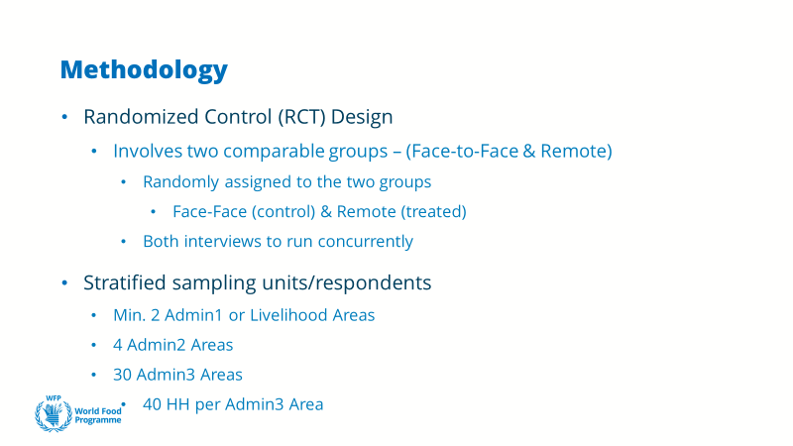
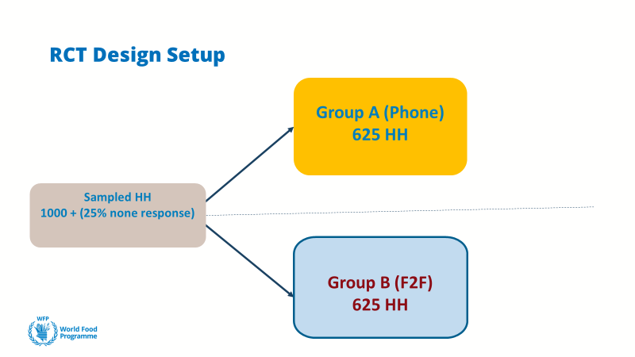
Sampling
700 HH
1400
700 HH

Slide 15
Discussion
Questions

Slide 16
DO
Enumerator Guideline_Do and Don’t
Introduce yourself and say goodbye politely.
Stay indivisibly with villagers. (e.g. sitting together on the same place)
Following local traditions and customs appropriately.
Keep polite and gentle manners when you are interviewing.
Explain patiently some complicated questions that villagers can not understand.
Ask question sharply.
If respondent answers unrelated facts, you should try to get him back right situation.
Fill the answer clearly in the questionnaire sheet.
Write your comments if you get confused answers.

Slide 17
DON’T
wearing valuable things (e.g. Jewelleries, necklaces )
Eating anything during the interview.
Speaking expectation things for villagers.
Avoiding giving promise that villagers requested things.
Do not interrupt respondent when they are answering.
Do not ask leading questions.
Avoid answering by your opinion on the questionnaire sheet.
Do not accept things from villagers (e.g. food, gift)

Slide 18
Colleague
Mutual Respect
Don’t argue in front of the community (can discuss later )
Listen to their ideas

Slide 19
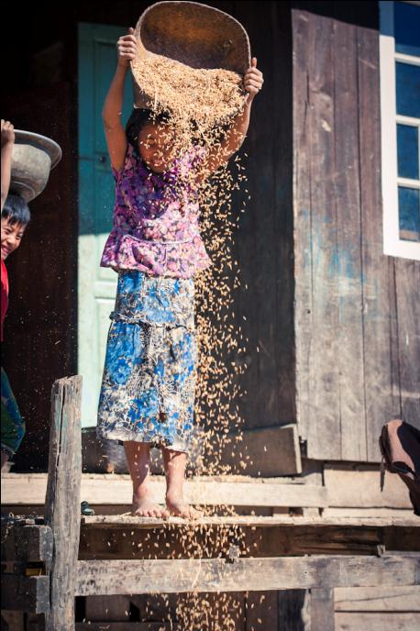
Thank you

Slide 20




Before you start the interview…
During the interviews, you will need:
Phone / tablet
Pen
Blank paper/notes book [for notes]
Enumerator reference sheet
Make sure that you are in a quiet space during the interview.

Slide 21
General principles of the questionnaire
Read out the questions as written.
Items in [brackets] are there to provide further clarifications. Depending on previous responses and/or need for clarifications, you may read them out loud or ignore them.
Refer to the entire of household unless otherwise indicated.
Pay attention to the reference period of each question!

Slide 22
General principles of the questionnaire
Lists of answer options are exhaustive and mutually exclusive for core questions.
That means that all possible answers provided by a respondent should have one and only one category.
The “Other” option should rarely be used.
Lists of answer option are mostly for your use only; except if otherwise indicated in the instructions. Let respondents answer spontaneously and choose the category that best fits their response. If you have any doubts on an answer provided, probe.

Slide 23
General principles of the questionnaire
FOCUS ON COLLECTING AS MUCH DETAIL AS POSSIBLE, DON’T JUST SETTLE FOR THE FIRST ANSWER A RESPONDENT GIVES, ASK FOR MORE!
To address this:
Read the full question to the respondent
Listen carefully to the respondent’s response. If they are struggling to answer or describe their answer, give them time … Do NOT offer an answer choice .
Select the answer category that best aligns to the response given by the respondent.
Only choose “Other” if you cannot align their answer with one of the choices available. This should happen rarely. Check with your supervisor if you find that it happens often.
Do not select “Don’t know” unless the respondent is unable to respond after probing.
Do not select “Refused” unless the respondent specifically refuses to answer the question.

Slide 24
Eligibility
Respondent must be knowledgeable on income sources, household’s expenditure and food consumption patterns of the household as a whole
Respondents should be over 18
Consent to participate to the survey

Slide 25
Consent form
Please read the consent form as written to the respondent. Key points:
Interview on behalf of WFP
Questions are related to the household access food, livelihoods, and coping strategies
All information is CONFIDENTIAL and will not be revealed individually
Participation is voluntary
Respondent participation is important to understand the situation
Participation does not increase or decrease chances of receiving assistance
Respondents will receive an incentive of 3,000 MMK(top-up)

Slide 26
Definition: household
A group of people who live in the same house/apartment; pool their income to buy essential goods and services (food, medication, education, health services); eat the same meals; and have only one person whom they all regard as the head of household.
Notes:
To translate (WFP)

Slide 27
Definition: household cont.
Remember:
•A member does not have to be related to other household members by blood or marriage.
•Any person who has spent at least six months with the household should be included as a usual member
•Make clear that questions refer to the group of people in the household, not just the respondent
•Make sure to include the head of the household, elderly & babies [sometimes unintentionally forgotten/left out]

Slide 28
Definition: head of household
A member of the household that is acknowledged as head by other members because of his/her age, or; standing in the household as the chief income earner; or, takes major decisions, including about the household budget.
Remember:
The head has primary authority & responsibility for household affairs.
In countries where short labour migration (< 6 months) is common, the head may be the person who is away.
Notes:
To translate (FAO)
If you are talking to the person currently in migration (e.g. transhumance), make sure to refer to income sources, consumption and agricultural production of the whole household back in the place of residence (e.g., family to whom they send money)

Slide 29


Is this a household member? True or false
House helper that normally lives and eats in the household
Farmhands come twice a week and sleep at the household but go home the rest of the time
Newly born baby
Seasonal worker temporarily away from the household but normally live and eat there
Son that has been away for 2 years to study outside
Newly married wife that just moved in with her husband in the household
A sick and elderly person living in the compound

Slide 30
Discussion
Questions

Slide 31
Food Consumption
Notes:
Note?

Slide 32
Food Consumption
The gold standard for measuring food consumption is in kilocalories
But the collection of detailed food intake data is difficult and time consuming
Collecting information on the diversity (which types of food) and frequency of consumption (how often) in the last 7 days is a validated alternative
Food Consumption Score (FCS) – A composite score based on the dietary diversity, food frequency, and relative nutritional importance of the various food groups consumed. The higher the FCS, the higher is the dietary diversity and frequency. High food consumption increases the possibility that a household achieves nutrient adequacy.
Food Frequency - Defined as the frequency (in terms of days of consumption over a reference period) that a specific food item or food group is eaten at the household level.
Food Group - Defined as a grouping of food items that have similar caloric and nutrient content.
Notes:
To translate (WFP)

Slide 33
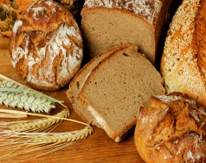
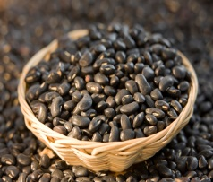
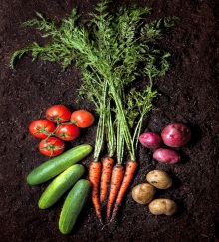


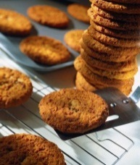

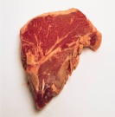
Food consumption Score - Module
During the call, you will ask the respondent how many days in the past 7 days at least 50% of the household members have eaten foods from the following 8 food groups : staples, pulses, vegetables, fruits, animal proteins, milk and dairy, fats, sugars

Slide 34
Food consumption Score - Module
For all food items, the recall period is set at the previous seven days.
Number of days eaten in past 7 days requires a numeric value ( 0 – 7 )
Ask respondents how many days (within the past week) their household consumed each of the food items/group s listed in the module and the respondent must answer on behalf of the entire household
Notes:
To translate (WFP)

Slide 35
Food consumption Score – Enumerator notes
If one member of a household consumes food away from the household, the items eaten should not be recorded.
Similarly, if a food item is consumed at home by only one household member it should not be recorded.
If the entire household ate outside of the household, then the foods consumed should be recorded.
Notes:
To translate (WFP)

Slide 36
Food consumption Score – Enumerator notes
Small Quantities Food items consumed in small quantities should not be recorded, because they cannot be considered as a proper portion for the entire household

Slide 37
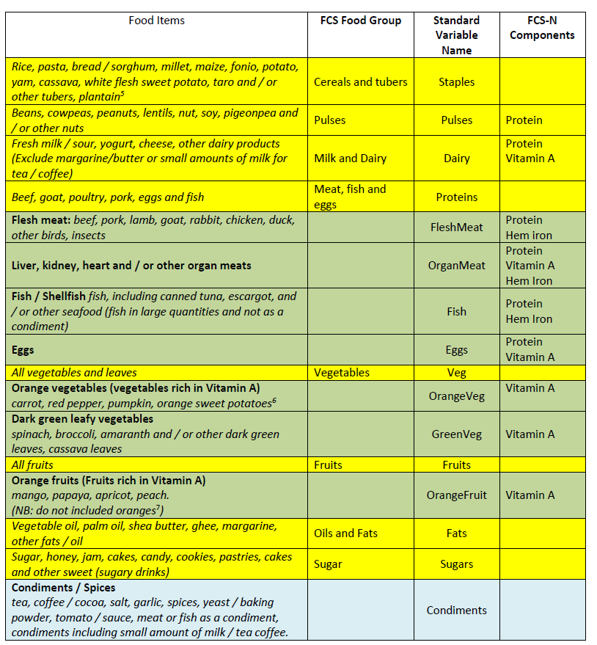

Slide 38
Coping Strategies Index (CSI)

Slide 39
Coping strategies index(CSI)
Coping strategies index (CSI) – A quick and simple indicator of household food insecurity behavior that reveals how households manage or cope with shortfalls in food consumption.
“What do you do when you don’t have enough food, and don’t have enough money to buy food?”

Slide 40
Coping Mechanisms
There are two basic types of coping strategies.
One includes the immediate and short-term alteration of consumption patterns.
Consumption Coping Strategy
Decrease Numbers of People (sending kids to neighbor’s house etc.)
Dietary Change( less preferred food, switching from preferred foods to cheaper, etc.)
Increase Short-Term Household Food Availability (borrowing, purchasing on credit, etc.)
Rationing Strategy( cutting potion size, reduce number of meal , etc.)
Livelihood Coping Strategy
The livelihoods-base includes the longer-term alteration of income earning or
food production patterns and one-off responses such as assets sales etc.

Slide 41
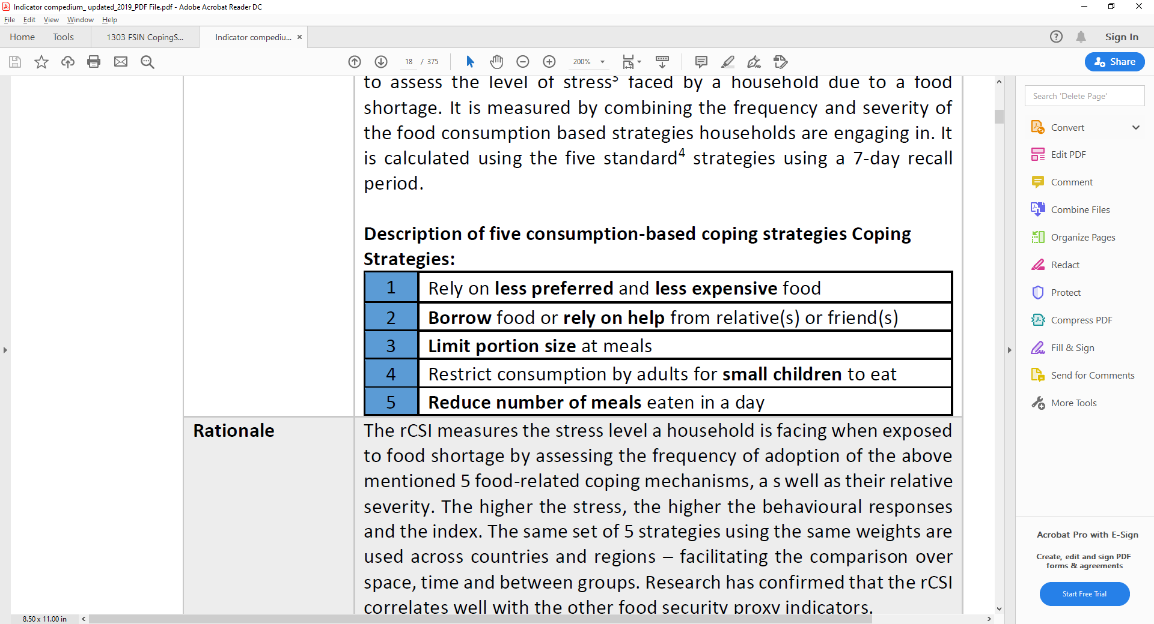
Reduced Coping Strategy Index (rCSI) – CSI food
Measures household consumption-based strategies for managing or coping with recent shortfalls in food or money to buy food
The recall period is the last 7 days!
“In the last 7 days, how many days did you ….”

Slide 42
Livelihood coping strategies (LCSI)
Measures food insecurity by considering the activities undertaken by households to respond to lack of food or money to purchase food
The recall period is the last 30 days!
These questions are about the loss of assets that are important for households' livelihoods: for example, if farmers typically save their seeds for the next campaign, consuming them is not only atypical, but also undermining future production.
A “coping strategy” is something you do to solve a problem, but it is a strategy that you would not rather not have used in normal times.
They are ordered by severity: the coping strategies become more and more severe as you progress in the questionnaire
Notes:
To translate (WFP)

Slide 43
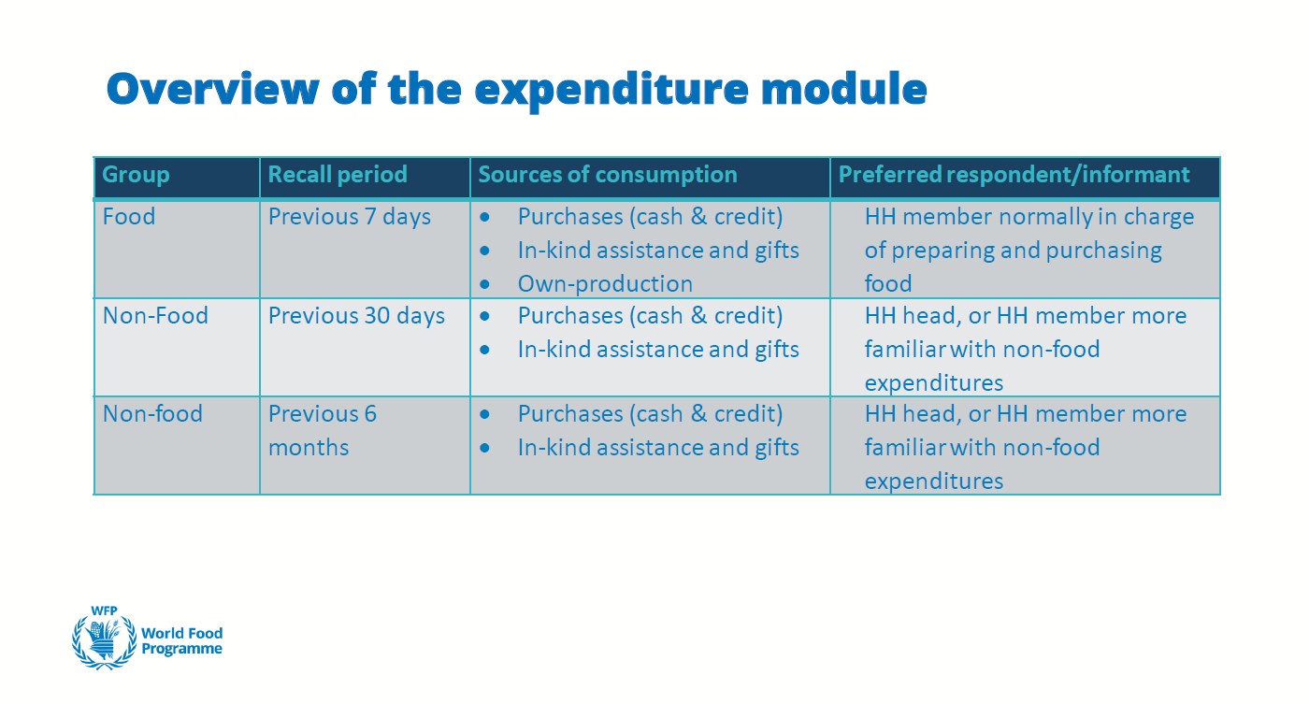
Expenditure

Slide 44
Expenditure
- For purchased items, we ask what the HH purchasedand how much it spenton these purchases
- For non-purchased items, we ask what the HH consumed and how much its value would be
objective is quantifying the value of what households consume
General considerations
Pay special attention to the different recall periods of sub-modules (7 days, 30 days, 6 months)
Always make sure that respondents understand that they are supposed to report on behalf of the whole household
Pay extra attention to zeros when entering values(e.g. careful of not writing 1,000 instead of 10,000!)
Make sure values are reported in required currency
Probe!

Slide 45
Income activity example
Wage Labor – Professional [liberal profession / doctor / architect / lawyer / including restaurant]
Wage Labor – Skilled [taxi driver with hired car/bus, dress designer(not running own business), pls add the relevant
Wage Labor - Unskilled/Casual/Agriculture
Wage Labor - Unskilled/Casual/non-agriculture [motorbike carry/ trishaw driver/ housemaid work/ cleaner/ helper/ food preparation assistant/ unskilled labour/ construction labourer/ manufacturing labourers/ etc], no fixed job]
Pension
Remittances
Aid/gifts
Borrowing money/Living off debt
High-risk activities
Begging, scavenging
Saving/selling assets
Petty trade/selling on streets [small-scale trade [5 or less employees]
Small trade (own business)
Medium/large trade (own business)
Small Agriculture production including livestock (own land/livestock)
Medium/large agriculture production including livestock (own land/livestock)
Other (specify) [ Collection and sale of forestry or bush products, Income not derived from work / Income from other rents ]

Slide 46
Food Insecurity Experience Scale (FIES)
Notes:
FIES hints
Q1. သင့်အိမ်ထောင်စုတွင်အစားအစာမလုံလောက်မှုအတွက် စိုးရိမ်ပူပန်ခဲ့ပါသလား။
Q2. ကျန်းမာရေးနှင့်ညီညွတ်သော အာဟာရပြည့်ဝသော အစားအစာများကို မစားရခြင်းများ
Q3. အစားအစာအမျိုးအစားစုံလင်စွာ မစားရခြင်း
Q4. အနပ်ကျော်စား( ပုံမှန်ထက် တနပ်မစားဘဲနေရခြင်း)
Q5.မိမိစားဖို့ လိုအပ်သည်ဟုထင်သော အစားအစာပမာဏထက် လျော့နည်းသောအစားအစာကိုသာ စားခဲ့ရခြင်း ။
Q6. စားစရာလုံးဝမရှိဘဲ အစားအစာပြတ်လပ်ခြင်း
Q7. အစာမစားရဘဲ ဆာလောင်မွတ်သိပ်စွာဖြင့် (ဘာမှမစားရဘဲ ဆာလောင်မွတ်သိပ်စွာနေခဲ့ရခြင်း)
Q8. အစာမစားရဘဲ ဆာလောင်မွတ်သိပ်စွာဖြင့် တစ်နေကုန်နေနေရခြင်းများ (မနက်နိုးချိန်မှစ၍ တနေ့လုံးဘာမှမစားရဘဲ ဆာလောင်မွတ်သိပ်စွာနေခဲ့ရ)

Slide 47
Food Insecurity Experience Scale (FIES)
Important aspects to keep in mind for this section:
Food insecurity is a socially and emotionally sensitive subject; be considerate and non-judgmental in your approach in order to elicit honest responses for FIES item
Responses to all 8 core questions must be recorded
Avoid prompting respondents for answers
- Make sure respondents understand the question is about themselves and other members of their household
-“because of lack of money or other resources” is asked for each question to ensure reported experiences are not due to other factors (religion, specific diet).
- “Other resources” are non-financial refers to the lack of other usual means for getting food, such as own production, barter, trade, small livestock for sale or own consumption, fishing, hunting or gathering, or the transfer of food from family, community members, government or donors.
-Used to clarify that reported experiences are not due to, for example, religious or diet-related health reasons
Make sure respondent reports an experience over the last 30 days
Notes:
To translate (WFP)
Avoid prompting respondents for answers.
Hesitation or uncertainty may indicate problems with understanding or sensitivity about answering a question for this section. If a respondent does not wish to answer “Yes” or “No” to any of the questions for the FIES section, a “Refused” response should be recorded.

Slide 48
Instructions for Individual Questions
FIES - Eight Key Questions
30 days recall Codes: No, Yes, Don’t know, I don’t want to answer
1. | You or others in your household worried about not having enough food to eat because of a lack of money or other resources? | |___|
Q1:You were worried you would not have enough food to eat?

Slide 49
Instructions for Individual Questions
2. | Still thinking about the last 30 days, was there a time when you or others in your household were unable to eat healthy and nutritious food because of a lack of money or other resources? | |___|
Q2: You were unable to eat healthy and nutritious food?
Notes:
By “kinds of foods you preferred” we mean foods that food secure people eat that food insecure people cannot afford to eat.Preference can refer to the form of a particular food (i.e., whole rice rather than broken rice), type of staple (i.e., millet vs. corn) or a high quality food (i.e., a piece of meat or fish). Preferred foods may or may not be nutritionally high quality.

Slide 50
Instructions for Individual Questions
3. | Was there a time when you or others in your household ate only a few kinds of foods because of a lack of money or other resources? | |___|
Q3: You ate only a few kinds of foods?
“a limited variety of foods”, we want to mean an undesired monotonous diet
E.g. might be tortilla and salt or rice and beans only.

Slide 51
Instructions for Individual Questions
4. | Was there a time when you or others in your household had to skip a meal because there was not enough money or other resources to get food? | |___|
Q4: You had to skip a meal?

Slide 52
Instructions for Individual Questions
5. | Still thinking about the last 30 days, was there a time when you or others in your household ate less than you thought you should because of a lack of money or other resources? | |___|
Q5: You ate less than you thought you should?
Eat less in either the morning or evening meal than you felt you needed..
By “meal” we mean the major eating occasions (not including snacks).

Slide 53
Instructions for Individual Questions
6. | Was there a time when your household ran out of food because of a lack of money or other resources? | |___|
Q6: Your household ran out of food?

Slide 54
Instructions for Individual Questions
7. | Was there a time when you or others in your household were hungry but did not eat because there was not enough money or other resources for food? | |___|
Q7: You were hungry but did not eat?

Slide 55
Instructions for Individual Questions
8. | Was there a time when you or others in your household went without eating for a whole day because of a lack of money or other resources? | |___|
Q8: You went without eating for a whole day?

Slide 56
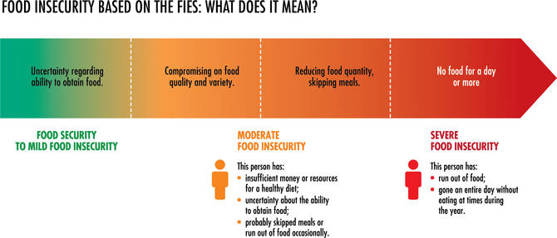
The Scale

Slide 57
Gender Empowerment-Questions

Slide 58
Discussion
Thank you!

